Slide 1

SAP HANA Workshop
Kapitola 1: Úvod
Jakub Vajda, konzultant

Slide 2
Obsah
Úvod

Slide 3
Obsah
Úvod

Slide 4



SAP HANA – Obsah
Seznam témat k prezentaci
Úvod
Potřeby moderní platformy
Jak do toho zapadá SAP HANA?
Základní popis funkcionalit
SAP HANA komponenty
Technologie
In-memory koncepty
Architektura Systému
Edice
Nasazení

Slide 5
Obsah
Úvod

Slide 6
SAP HANA – Úvod
(Dnešní svět)

Slide 7
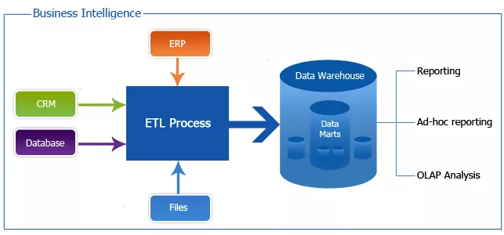
SAP HANA – Úvod
Výzvy
Aplikační “sila”
Mnohonásobné rozkopírování dat
Dávkové zpracování
Částečný náhled na business
Žádná real-time analýza
Omezená možnost inovací
Finance
Predict

Slide 8
SAP HANA – Úvod
Jedna platforma pro všechny aplikace
Spojené aplikační vytížení
Spojená data – jedna kopie
Zpracování real-time
Kompletní náhled na business
Možnost real-time odpovědi
Možnost inovovat
CRM app
Finance app
Predict app

Slide 9
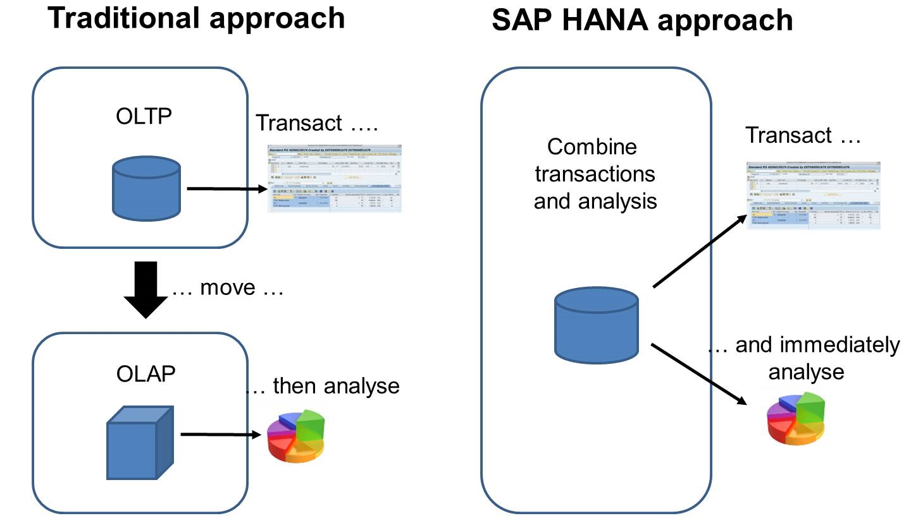
SAP HANA – Úvod
Jedna platforma pro všechny aplikace

Slide 10
SAP HANA – Úvod
Co je SAP HANA?
SAP HANA ~ modern, in-memory database + platform deployable on-premise or in the cloud

Slide 11
SAP HANA – Úvod
Co je SAP HANA?
SAP HANA ~ modern, in-memory database + platform deployable on-premise or in the cloud
MaxDB (with in-memory liveCache engine) ~ 1997 - 2000
TREX search engine became SAP component in 2000
P*Time (in-memory OLTP) acquired by SAP in 2005
Sybase acquired by SAP in 2010 (Sybase integrated)
1st platform demonstration 2008 (Hasso Platner Institute)
1st product shipped in late November 2010
1st managed private cloud service in May 2013
2nd version of HANA announced in November 2016

Slide 12
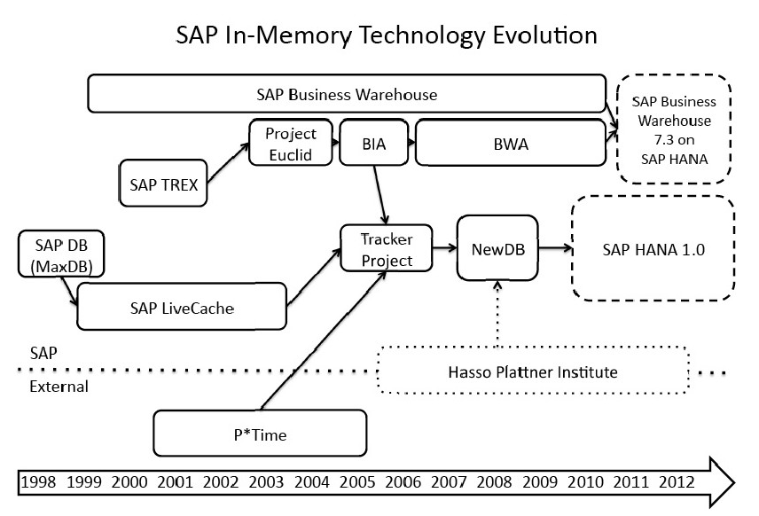
SAP HANA – Úvod
Co je SAP HANA?
SAP HANA ~ modern, in-memory database + platform deployable on-premise or in the cloud
MaxDB (with in-memory liveCache engine) ~ 1997 - 2000
TREX search engine became SAP component in 2000
P*Time (in-memory OLTP) acquired by SAP in 2005
Sybase acquired by SAP in 2010 (Sybase integrated)
1st platform demonstration 2008 (Hasso Platner Institute)
1st product shipped in late November 2010
1st managed private cloud service in May 2013
2nd version of HANA announced in November 2016

Slide 13
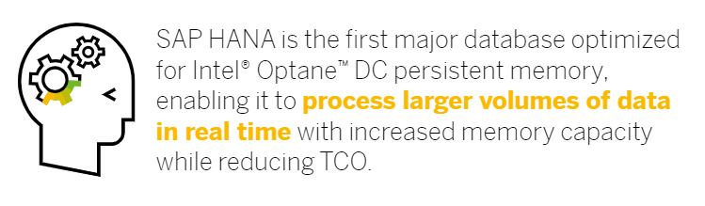
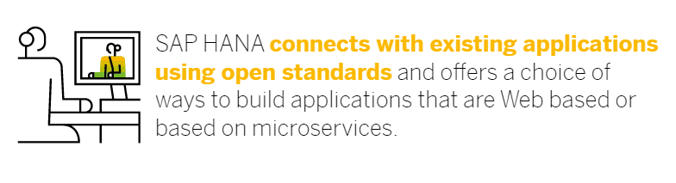
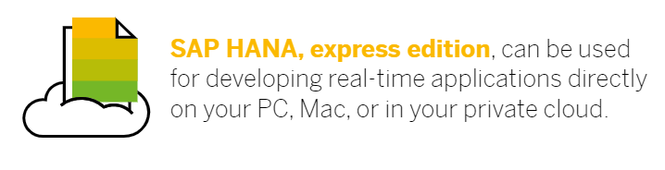
SAP HANA – Úvod
SAP HANA jako moderní platforma
SAP HANA ~ modern, in-memory database + platform deployable on-premise or in the cloud
Zdroj https://www.sap.com/products/hana.html?pdf-asset=9629f881-217c-0010-82c7-eda71af511fa

Slide 14
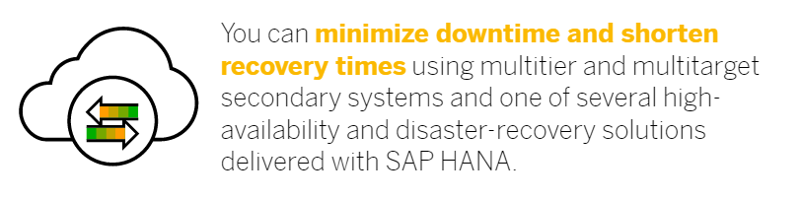
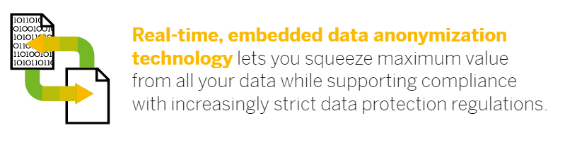

SAP HANA – Úvod
SAP HANA jako moderní platforma
SAP HANA ~ modern, in-memory database + platform deployable on-premise or in the cloud
Zdroj https://www.sap.com/products/hana.html?pdf-asset=9629f881-217c-0010-82c7-eda71af511fa

Slide 15
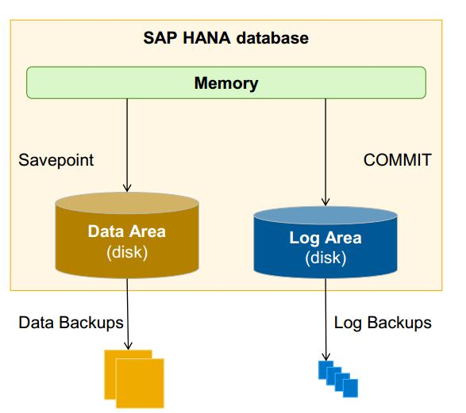
SAP HANA – Úvod
In-memory
SAP HANA ~ modern, in-memory database + platform deployable on-premise or in the cloud

Slide 16
SAP HANA – Úvod
Databáze a platforma
SAP HANA ~ modern, in-memory database + platform deployable on-premise or in the cloud

Slide 17
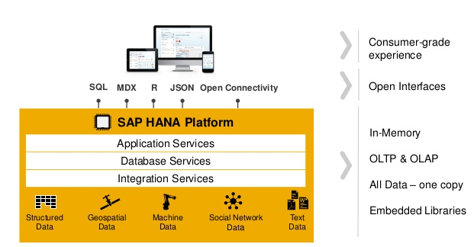
SAP HANA – Úvod
Databáze a platforma
SAP HANA ~ modern, in-memory database + platform deployable on-premise or in the cloud

Slide 18
SAP HANA – Úvod
Cloud vs On-Premise
SAP HANA ~ modern, in-memory database + platform deployable on-premise or in the cloud

Slide 19
SAP HANA – Úvod
SAP HANA
SAP BW powered by SAP HANA
SAP BS powered by SAP HANA
SAP S/4 HANA
Powering SAP Enterprise Applications with SAP HANA
In-memory platform
Real-time analysis
Real-time reporting
Real-time business
OLAP + OLTP
SAP HANA Enterprise Cloud for SAP Business Suite on SAP HANA
Simplified data model
New user experience
Advanced processing
Choice of deployment
Multitenancy
2010
2011
2012
2015

Slide 20
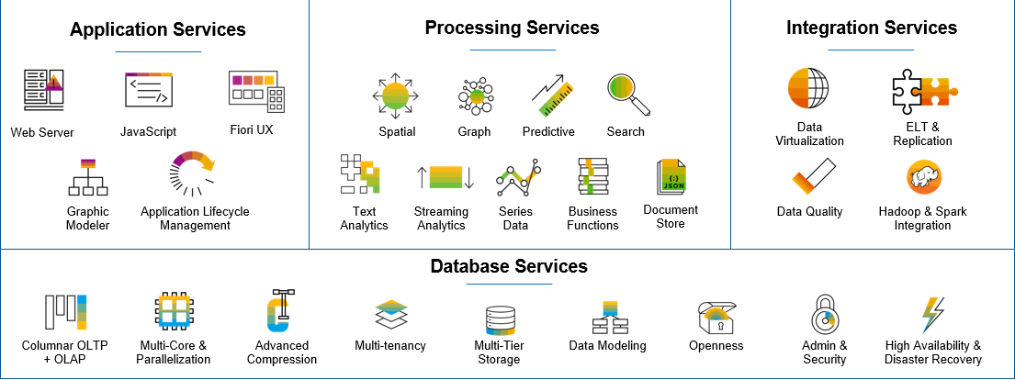
SAP HANA – Úvod
Přehled platformy

Slide 21
SAP HANA – Úvod
Structured data
Text Data
Spatial Data
Graph Data
SAP HANA Platform
Data Types
Data Sources
Typy dat a zdrojů
Enterprise Systems (ERP)
Data Warehouses
Archives
Big Data
File Stores
Databases
Social Networks
Sensors

Slide 22
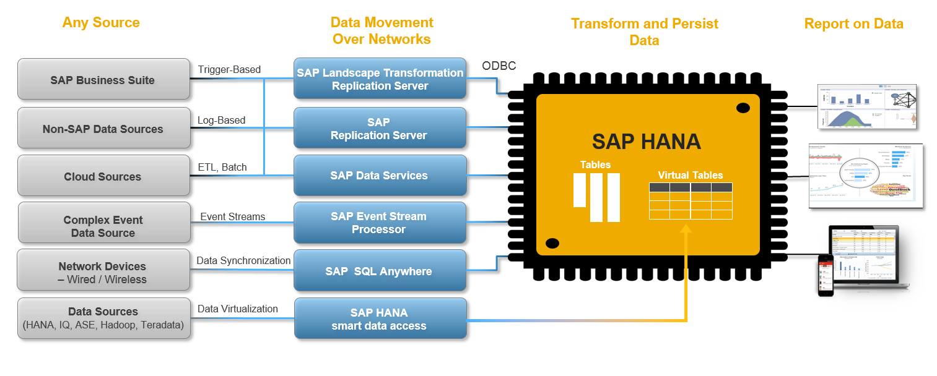
SAP HANA – Úvod
Typy zdrojů, přenosů a výstupů

Slide 23
SAP ERP
SAP Business One
SAP Success Factors
…
SAP HANA
Enterprise Suites
Data Warehousing
Disk DB App Accelerators
Packaged Apps
Database
OEM ISV Apps
SAP HANA – Úvod
Scénáře nasazení
General Purpose Database
SAP BI on Demand
2 & 2.5 tier applications
SAP Smart Meter Analytics
Cash and Liquidity Mgmt
SAP CO-PA Accelerator
Customer Segmentation
SAP ERP Operational Reporting Acc
SAP NetWeaver Business Warehouse
Real-time Data Marts
Medidata, MKI, Taulia, Opera, …

Slide 24
SAP HANA – Úvod
Access data anywhere

Slide 25
SAP HANA – Úvod
Verze

Slide 26
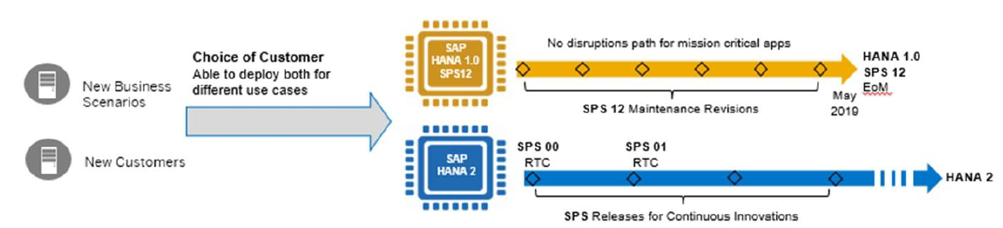

SAP HANA – Úvod
Maintenance schedules / Upgrade paths

Slide 27
SAP HANA – Úvod
Výběr konfigurace

Slide 28



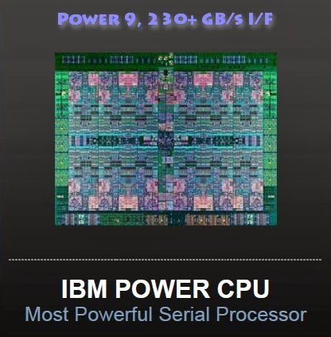
SAP HANA – Úvod
Podporované operační systémy a chipsety

Slide 29

Děkuji za pozornost
Jakub Vajda
konzultant
Jakub.vajda@mdsaptech.cz
linkedin.com/company/mdsap
@MDSapTech
slideshare.net/MDSapTech
www.mdsaptech.com

